Slide 1
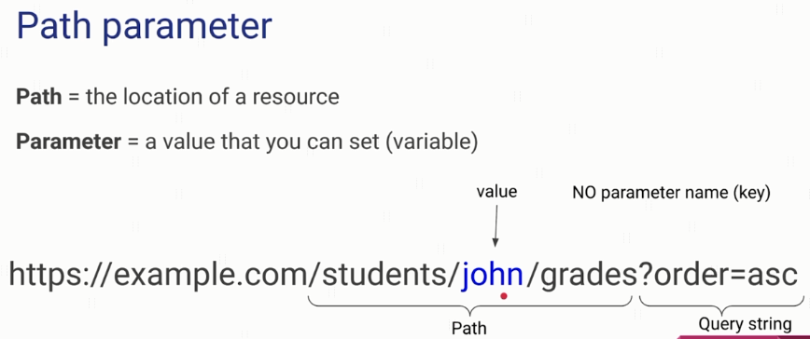
What are Path Parameters?

Slide 2
What are Query Parameters?
https://openlibrary.org

Slide 3
HTTP Message Structure
https://www.udemy.com/course/introduction-to-apis-rest-api-graphql-soap-web-services-grpc/learn/lecture/19945594#overview

